Slide 1
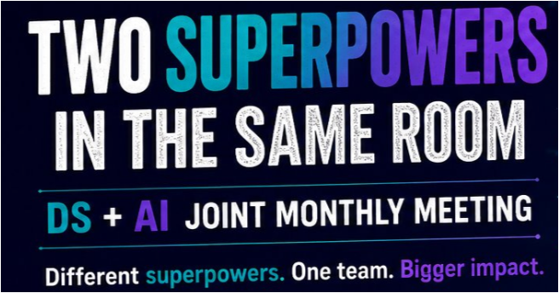
AI Engineering
Data Science
Joint
Function Monthly Meeting
Jul 17, 2026
Blend360.com

Slide 2
Agenda
1
Hackathon callout!
2
Top Agenda Items for the Functions (10 Minutes)
3
AI – DS Cross Upskilling (5 Minutes)
4
OpenAI & Codex (10 Minutes)
5
Better Together Delivery Story: Evals at Vialto (15 Minutes)
6
Better Together Delivery Story: Charter (15 Minutes)
7
Ask Us Anything (5 Minutes)
Notes:
J

Slide 3
Hackathon Callout

Slide 4
The Project Intelligence Hub
Every project we deliver generates knowledge worth keeping; almost none of it lands somewhere a colleague can find later.
The goal of the hackathon is a solution that can answer questions about our existing projects — and turn what it knows into shareable artifacts.
Prizes
🥇 $300 gift card for each team member
🥈 $150 gift card for each team member
🥉 $75 gift card for each team member
Logistics
📍 Location: Regional offices & remote teams
🕐 Time: 6:30 AM – 4:30 PM (ET) / 4:00 PM – 2:00 AM (IST)
🗓️ Date: July 24, 2026
👥 Team size: 3–5 members
🌍 Cross-regional teams strongly encouraged
Deliverables
📹 video demoing your solution
📄 CSV document with a set of questions and answers for our automated evaluation
🖼️ a project one-pager, generated with a given prompt
Notes:
Victoria

Slide 5
Top Agenda Items for the Functions

Slide 6
Data Science and AI Engineering Top Agenda Items
Jeff Chen and Celia
Recruitment
Career Ladder, Skills & Competencies
Agentic Engineering
Other Jeff and Serhat
Knowledge Repo
Career Matrix - IC Track
Project Rotation
Snowflake Certification
Notes:
J

Slide 7
AI Engineering Career Framework
Shared levels through Lead AI Engineer; the track splits at Principal AI Engineer I / Manager. Same-column levels are equivalent grades.
Technical Path
Principal AI Engineer I
Principal AI Engineer II
Principal AI Engineer III
Principal AI Engineer IV
Principal AI Engineer V
Fellow
Senior Fellow
Shared foundation
AI Engineer
Senior AI Engineer
Lead AI Engineer
Manager
Senior Manager
Associate Director
Director
Senior Director
VP
SVP
Management Path
Detailed reference: Link

Slide 8
AI DS Cross Upskilling

Slide 9
AI DS Cross Upskilling
  Key Learnings:
  Asynchronous workflows
  Rate limiting strategy to optimize resources
  Agent architecture and orchestration
  Understand and build production MCP server
  Build multi-agent pipeline
  What worked well:
  Hands on project-based learning
  Clear learning progression from basic to advance concepts
  Production ready AI agent solutions
  Final Evaluation
Notes:
J

Slide 10
OpenAI & Codex

Slide 11
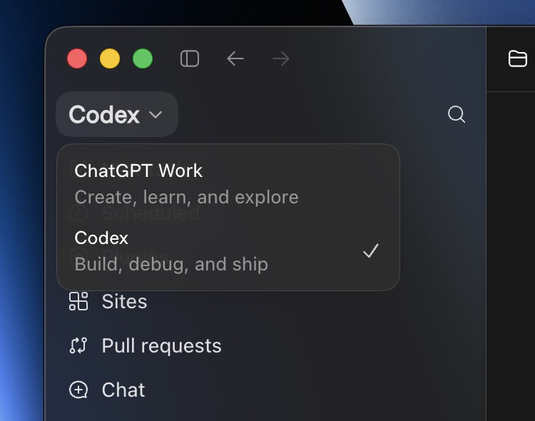
What is Codex?
OpenAI's agentic coding assistant — since July 9 it lives inside the unified ChatGPT desktop app alongside ChatGPT Work (Mac & Windows).
Codes for you: writes, refactors, fixes bugs, generates tests, explains logic
Runs long tasks: plans & executes across hundreds of tool calls, self-checks
Reviews & iterates: inline diffs, PR review, in-app browser, SSH to devboxes
Runs anywhere: cloud sandbox for parallel jobs + local CLI with approvals
Illustration of the unified desktop app (ChatGPT Work / Codex).
Swap in a live screenshot before presenting.
Use the desktop app, not the CLI: multi-file & multi-terminal view, PR review and an in-app browser make it the stronger day-to-day surface.
Notes:
~1:30 | Codex = OpenAI's agentic coding tool. Since July 9 it lives inside the unified ChatGPT desktop app next to Chat and Work (Mac & Windows). It codes for you, runs long multi-step tasks, reviews PRs with inline diffs, runs in a cloud sandbox or local CLI. Push the desktop app over the CLI - richer surface.

Slide 12
Codex + Claude at Blend
Both are Enterprise-approved tools at Blend — and both are here to stay. Our clients use each, so we need fluency in both.
ChatGPT Work / Codex (OpenAI)
Claude Cowork / Code (Anthropic)
Top tier desktop app; feature-rich side panel
background computer use
Lightning-fast history compaction with higher quality
Import skills/projects from claude
More standard setup like AGENTS.md
SSH connection
Top tier CLI for coding
Claude Cowork makes better decks
Larger context window (but weak compaction quality)
Already established at Blend
Running detached on remote machine, connect later from desktop app
How they work together Not a replacement — a complement.
IT's guidance: they're very similar — try both and use what fits the task. You can spend your limits across either tool. If you already lean on Claude, put Codex on real work this quarter.
Notes:
~1:15 | Both Codex and Claude are Enterprise-approved and both stay - our clients use both. Not a replacement, a complement. IT says they're similar: try both, use what fits. You can spend limits across either. Ask: if you already live in Claude, put Codex on real work this quarter.

Slide 13
Codex Limits, Cost & Responsible Use
TODAY
SEPTEMBER PLAN
~$160 / mo
~$50 / ~$125
Today's cap: 4,000 credits
Planned Sep caps: standard / advanced
Why caps? They stop a runaway agentic process from creating a huge bill. Licensing: sign-ups before Jun 30 are Codex-only (100% usage-based); after, it's $20/mo ChatGPT + Codex + API usage.
Need more? Request an increase
Use tokens responsibly
Where: Blend intranet or rex.blend360.ai
Approval: simple manager sign-off
Directors+: auto-approved
Standard or custom caps at any amount
Scope tasks — don't leave agents running unattended
Close idle ChatGPT seats — min $20/mo each
Don't burn tokens on trivial one-off calls
Prefer Codex-only (usage-based) if you're light
Notes:
~1:30 | Today's cap ~$160/mo (4,000 credits); free OpenAI tokens through Aug 31 so cap set high. Planned Sep caps ~$50 standard / ~$125 advanced, mirroring Claude. Caps stop runaway agent bills. Licensing: pre-Jun 30 = Codex-only usage-based; after = $20/mo ChatGPT+Codex+API. Need more? rex.blend360.ai; manager approval, auto for directors+. Use responsibly.

Slide 14
Governance & Data
Enterprise accounts only. The rules that keep Blend and client data safe.
Never use personal or free accounts for work. They lack enterprise protections, and your data may be retained or used to train the provider's models.
Keep sensitive data out of unapproved tools. No Blend confidential, client, regulated, or personal data in personal / free accounts unless explicitly approved.
Plugins go through IT. Codex has an org-wide plugin store, but there's no self-serve — request adds/removes through IT, who own plugin governance.
Seat hygiene keeps costs down. ChatGPT seats may be reclaimed after 60-90 days of inactivity; Codex-only is usage-based, so idle seats cost nothing.
Notes:
~1:15 | Enterprise accounts only. Never personal/free accounts for work - no protections, data may be retained/trained. Keep confidential/client/regulated/personal data out of unapproved tools. Plugins go through IT (no self-serve). Seat hygiene: ChatGPT seats reclaimed after 60-90 days idle; Codex-only is usage-based.

Slide 15
OpenAI Partnership — Training & Enablement
The partnership gives us structured ways to skill up fast.
Codex Training Cohort
Partner U + Certification
Office Hours
Kicked off Tuesday.
Three tracks to self-select:
• Leader
• Developer
• Knowledge Worker
Get Codex-certified.
~3 hours, self-paced
No major exam
Everyone should grab it.
Live help & Q&A.
Recurring sessions with
OpenAI + internal experts
Details coming soon.
Start the Codex certification — ~3 hours, no big exam
Erik Wischhusen on Viva Engage: Interested in learning more about OpenAI? As part of our partnership, we have access to their training portal now. Please follow the below steps to g...
Notes:
~1:15 | Partnership training. Codex cohort kicked off Tuesday - three tracks (Leader/Developer/Knowledge Worker). Partner U + certification: ~3 hrs, no major exam. Office hours coming soon. THE ask this week: start the cert.

Slide 16
Partnership — Community & Business
Beyond tools, the partnership opens engagement and pipeline.
External Hackathons
Internal Development
Co-Sell & Co-Build
On client sites.
Blend hosts; client employees join
Sponsored by OpenAI
Showcase delivery + build relationships
Hackathon for Blend teams.
OpenAI-sponsored, internal events
Turn learning into shipped ideas
Delivery Enablement
Reusable technical patterns
Readiness for delivery teams
Goverance
With OpenAI.
Co-sell, co-design, co-solution
More joint opportunities
Boosts Blend's credibility in market
Net effect: more reps with the tools, more visibility with clients, and stronger positioning for Blend in the market.
Notes:
~1:00 | Community + business. External hackathons on client sites (OpenAI-sponsored). Internal hackathons for Blend teams (OpenAI-sponsored). Co-sell/co-design/co-solution with OpenAI = more pipeline + credibility.

Slide 17
Roadmap & Open Models
Near-term roadmap
Open Models — investigating
Drive adoption + land certifications across the function
No Blend consensus yet. Placeholder so the question is on the table — here's what we're working through:
Run the first hackathons (internal + client-site)
Do we adopt open models at all?
Stand up office hours and share the schedule
Which provider / hosting?
Finalize post-August caps with Mike F. & Tommy
How does Blend fund it centrally?
What's the governance model?
Size spend vs. throughput so we can set expectations
Short-term reality: stay on OpenAI + Anthropic while we size how much Blend will fund and what it can deliver.
Notes:
~1:15 | Roadmap: drive adoption + certs, run first hackathons, stand up office hours, finalize post-Aug caps with Mike F. & Tommy, size spend vs throughput. Open models: no Blend consensus yet - this is a placeholder. Questions we're answering: adopt or not, which provider, how we fund centrally, governance. Short term stays OpenAI + Anthropic. Total section ~9-10 min.

Slide 18
Better Together Delivery Story: Evals at Vialto

Slide 19
Delivery Story – Evals at Vialto
01
Context
Vialto, and Blend’s Vanguard & Vlabs projects
04
Development – Vlabs Evals
Plugin Enhancement Framework
02
Definitions
Measure progress, and AI eval components
05
Next Steps – Self improvement loops
Loops & automatic enhancement of skills
03
Development - Vanguard Evals
VG Experiment Framework
Notes:
Problem/solution in one breath: hours consumed by casework; the AI-augmented service model gives them back. No figures on purpose.

Slide 20
Vialto Partners & Business Case
01 - CONTEXT
Turning Vialto's manual, document-heavy casework into a scalable, AI-augmented service model
What is Vialto?
What does Blend build?
End-to-end global mobility: immigration, tax, rewards, advisory & private client services, unified on one data & AI platform.
Opportunity: expert hours are consumed by manual, document-heavy casework.
Proposal: AI system to automatically process tax & imm. cases, boosting productivity.
Agentic AI assistants
augment caseworkers on manual, document-heavy tasks
Automated workflows
standardized global processes, end to end
Tax
Immigration
Rewards
Advisory
Private
Dashboards & transparency
shared visibility on work and data across service lines
One platform across all services
Agile pod-based delivery
solutions designed and iterated with the business
The starting point: a scale-ready operating model slowed by manual, fragmented processes — raising cost-to-serve across documents, cases, coordination and billing.
Tax
Immigration
Value across:
Notes:
Sander presents this slide

Slide 21
From Vanguard to Vlabs – the 10X Boost
01 - CONTEXT
From building and running every layer, to authoring skills on Claude.
VANGUARD
VLABS
Build on Claude — author skills, not infrastructure
Custom web UI
Claude Cowork app
provided platform
Custom API agents (one per task)
10×
BOOST
Agent runtime (Google ADK/ MAF)
Plugins & Agent Skills
the only layer we build (business knowledge)
Azure AKS Infra
Data layer (FastAPI · CosmosDB)
Managed runtime · data · ops · evals per skill
now each engineer/dev evaluates their own work
Ops, exclusive eval teams & multi environments
COVERAGE INCREASE – FROM 20% TO 100% IN WEEKS ON UK TAX
1 · Intake
2 · Position
3 · Prepare & Calc
4 · Validate
5 · Output
Vanguard Coverage
Vlabs Coverage
AI-FIRST PRINCIPLES — WHY 10×
Autonomous Agents
Multi-Shot Engineering
Rapid Deploy & Improve
Non-Linear Processes
AI-Enabled Code
5×
user productivity
10–20×
concept to prototype
3–5×
faster time to value
30–60%
cycle-time reduction
5–10×
engineering productivity
Notes:
Rolo presents this slide | Add

Slide 22
02 - DEFINITIONS
Measuring Progress
From vague to specific: what actually makes one process “better”?
Speed
How fast the pipeline runs, end to end.
Cost
Dollar cost to run each execution.
Token efficiency
Tokens consumed per unit of useful work.
Subjective criteria
Quality of the output: where “better” stops being obvious.
The requirement
To have a unique definition of improvement, general enough to apply to every pipeline we ran, and configurable, so that it could vary by country and by process.
Notes:
Rolo presents this slide

Slide 23
02 - DEFINITIONS
The Anatomy of Evaluation
Without evals, teams fly blind as agents scale; with evals, quality becomes defined, testable, and measurable.
EVALUATION STRUCTURE
HOW EVALS FIT TOGETHER — THE SWISS CHEESE OF QUALITY
TASK
TRIAL ×N
GRADERS
VERDICT
+ reference / GT
Automated evals
consistent measurement · baselines · catches regressions before deployment
A task with defined success criteria (and ground truth); multiple trials because outputs vary; graders score both the transcript (the path) and the outcome (the end state).
EVALUATION GRADERS
CODE
LLM-AS-JUDGE
HUMAN
Manual review & judges
catches nuanced failures and unexpected user or agent behavior
✓ fast · cheap · objective
✓ flexible · scalable · nuanced
✓ gold-standard judgment
✗ brittle to valid variation
✗ variable · needs calibration
✗ slow · costly · needs experts
Production monitoring, A/B tests & user feedback
surfaces rare edge cases and real usage patterns at scale
EVALUATION TYPES
Capability — “what can it do well?”
graduates
Regression — “does it still work?”
≈100%
No single evaluation layer catches every issue. With multiple layers combined, failures that slip through one are caught by another.
starts low; climbs as you improve
stays ~100%; a drop = something broke
Source: anthropic.com/engineering/demystifying-evals-for-ai-agents (Jan 2026).
Notes:
Sander presents this slide

Slide 24
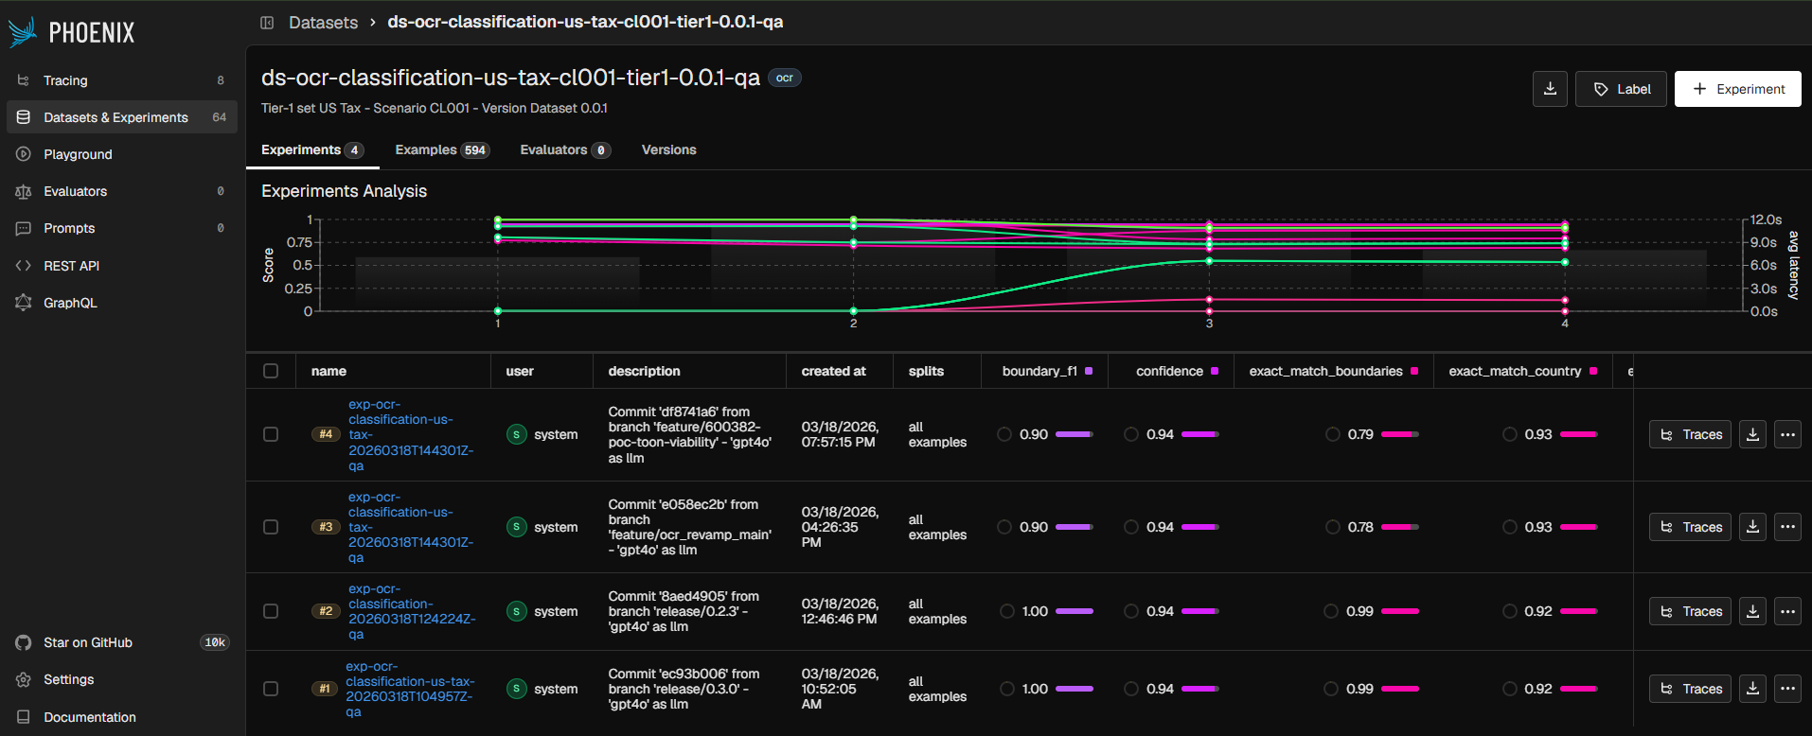
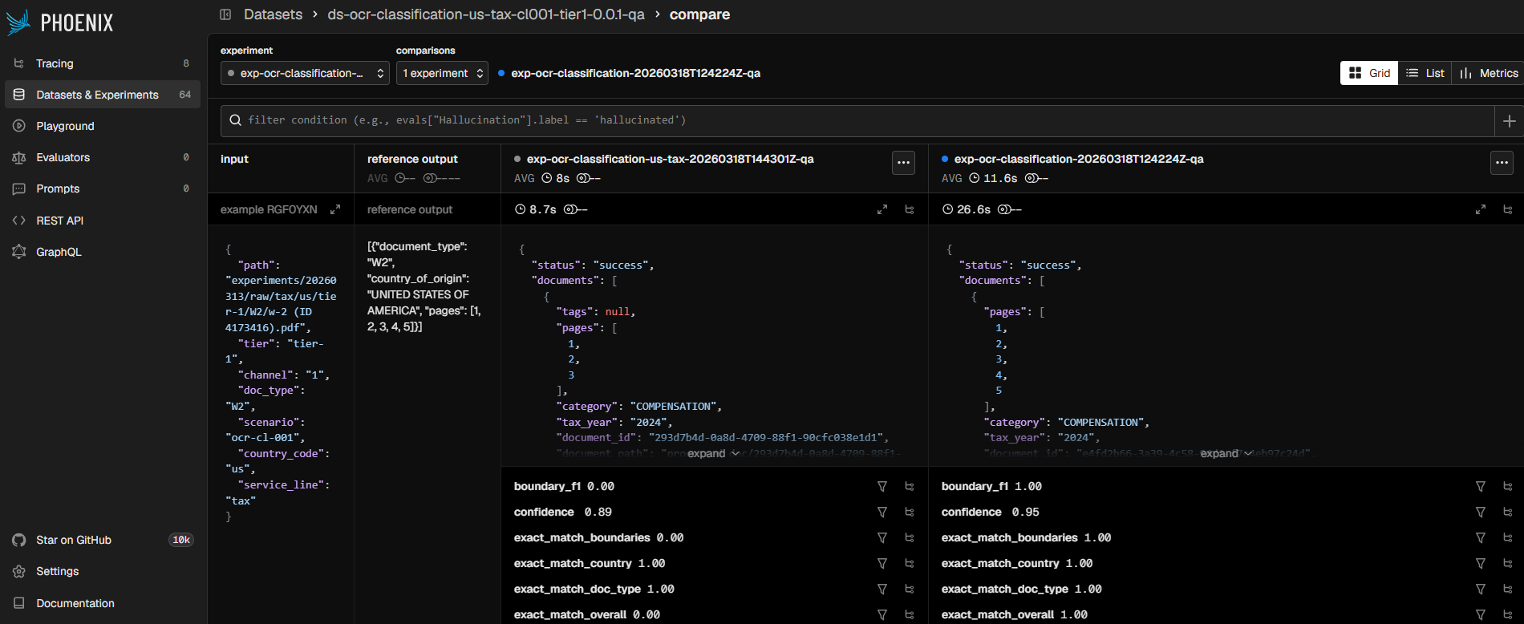
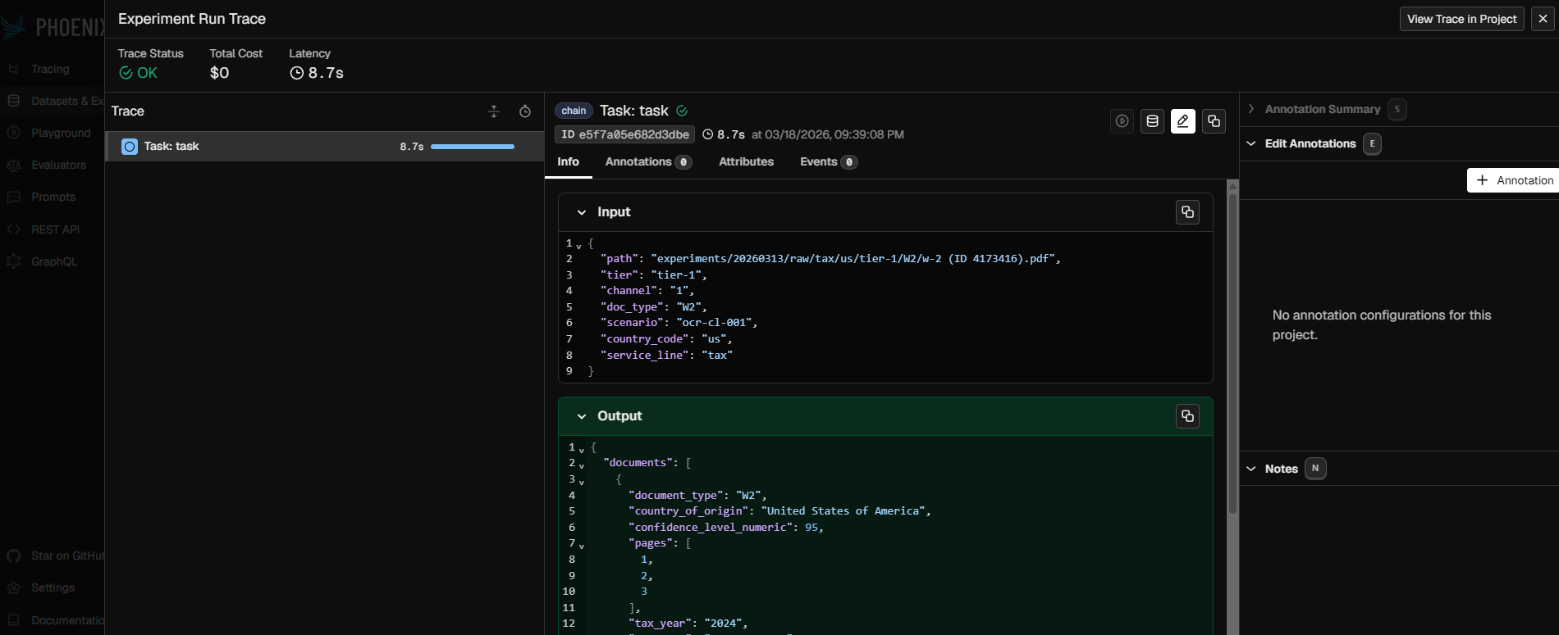
Vanguard Evals — Plan & Results
03 – DEVELOPMENT – VANGUARD EVALS
An end-to-end evaluation framework — VG-Experiments package which automates the engine (Phases 3–4)
1 · The 5-Phase Evaluation Framework
VG-EXPERIMENTS · auto P3–4
01
02
03
04
05
Design Experiments
Collect GT
Run Agents
Compare
Review & Refresh
Define evaluators
Golden datasets (MVGT)
1+ replications
Code + LLM judge
Dashboards, drift
Scenarios, hypotheses & power analysis
SMEs label 20–100 - Tiers Samples – Blob Storage
Fixed seed · traces · cost
Effect sizes + confidence intervals
Versioned runs + observability
2 · One Pattern for Every Agent
Dataset
Versioned GT in Phoenix
+
Task
Calls the agent / feature
+
Graders
Score the output
User / Client
→
VG-Experiments API
→
Azure Blob
→
Phoenix
→
VG Agents
3 · Phoenix — the Review Surface
4 · Current Results by Agent x Scenarios
OCR
Classification & Splitting
~ 0.91
Avg. Accuracy
OCR
Extraction & Bounding Boxes (LLM Judges)
~ 0.96
Avg. Correctness
Overall view
Compare view
Traces & spans
DC
Mapping (LLM Judges)
~ 0.94
Avg. Correctness
WHAT PHOENIX GIVES THE TEAM
• Versioned datasets + every run
• Automated evals — code + LLM judge
ISI
Case Assessment
~ 0.95
Avg. Jaccard (Recommendation overlap)
• Full observability — traces & spans
• Cost & token tracking per run
Notes:
Sander presents this slide

Slide 25
PEF — Plugin Enhancement Framework
04 – DEVELOPMENT – VLABS EVALS
Every plugin change takes the same exam: what it promised, what it did, and whether that is better than before.
1 · THE EXAM — HOW A CHANGE IS GRADED
1 · Contracts
2 · Run
3 · Marking
4 · Verdict + Gate
Contract: inputs, outputs, acceptance criteria frozen with the owner
New version runs; log output + cost (time · money · tokens)
Every contract checked — code checks + calibrated AI judge
better · unchanged · regressed
REGRESSION ✕ CAN'T SHIP
2 · FOUR QUESTIONS EVERY VERDICT ANSWERS
Efficiency
Integrity
Correctness
Quality
Is it faster and/or cheaper?
Is everything intact?
Are the answers it provides right?
Does it match the specific criteria set by owners?
3 · EVALUATION ARCHITECTURE — ONLY THE LAST LAYER MOVES
L1
Integrity
handoff · valid state · pipeline completed
WRITTEN ONCE
L2
Quality dimension
stable rubric: inputs · criteria · output · ambiguity
STABLE
L3
Instantiation
per-stage tests generated from the contract
AUTO · PER STAGE
Graded per-stage (pinpoint attribution) + end-to-end (integration) · Two suites: regression — did it break? · improvement — did it get better? (pairwise)
4 · DELIVERY — WHERE WE ARE
P1
LIVE
P2
IN PROGRESS
P3
NEXT
P4
THE LOOP
Monitor every stage
Contracts & code checks
AI judge & quality
Feedback-driven loop
Notes:
Rolo presents this slide

Slide 26
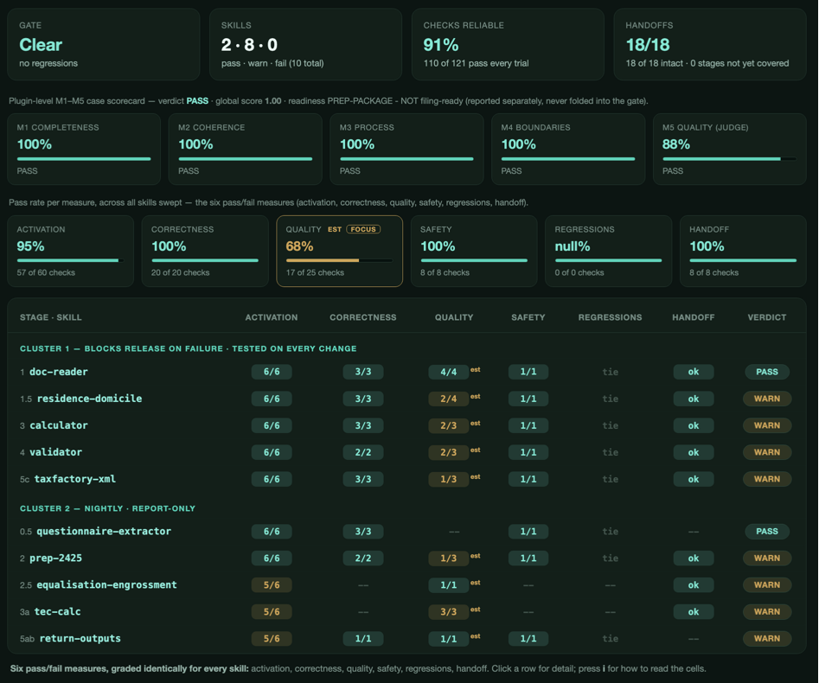
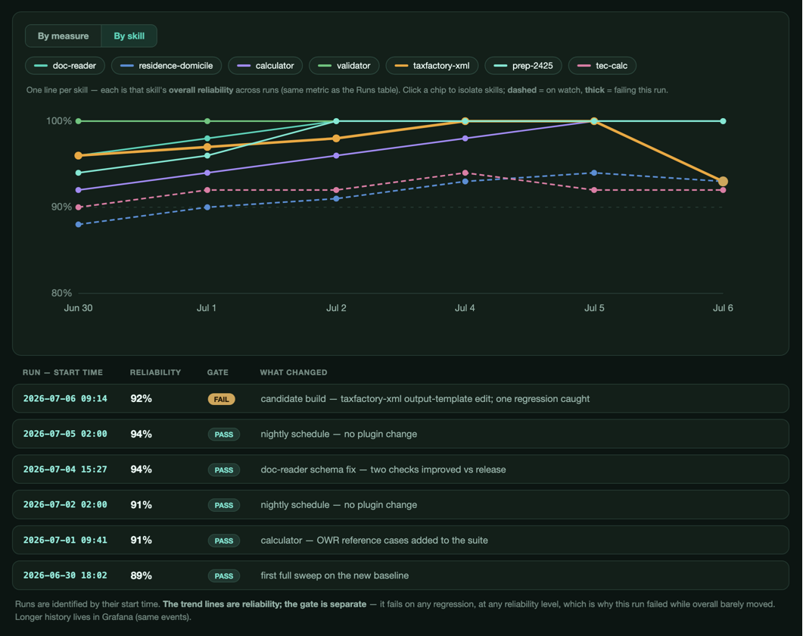
Early Eval Results — Per-Skill Scorecards
04 – DEVELOPMENT – VLABS EVALS
Isolated component-level tests already run locally on every completed case
FROM IN-SESSION (n = 1) TO CROSS-SESSION (n > 1) · Aggregate per-session evals via OTEL to gain representativity
Case artifacts
output files + state of a finished session
Graders sweep
deterministic & non-deterministic checks per
Skill (pass@k)
Per-session eval results
scored each session → HTML report + PEF
emit-event → OTEL
tag: skill · version ·
session · pattern
Collector → Loki → Grafana
+ Vialto Data Platform
Group across sessions
rates + CIs + drift + pass^k
Representative view
Tier 0..3 evidence; no reference re-run
* Currently implemented
↑ IN-SESSION (n = 1) - A single completed evaluated case
Production sessions are the sample: ref-free metrics aggregate now; output accuracy follows as feedback earns references.
pass^k: release-gate only, isolated trials. CI runs N=1 ref-free. Stats phased — trend now, CIs / Holm-Bonferroni at release-N.
Notes:
Sander presents this

Slide 27
Next Steps — Self-Learning Loops
05 – NEXT STEPS – SELF LEARNING LOOPS
From evals that measure to evals driving improvement with a human-ratified boundary.
01
02
PRODUCTION TRACE
Every session
FAILURE SIGNAL
Caseworker feedback & errors
CLAUDE COWORK
Human reviewed and taken into account by volume
trace
eval
repo
skills
reads everything, proposes the fix
04
03
PRODUCT CHANGE
Shipped fix after review
LOOP
Enhancement prompt with feedback + PEF verdict
Source: https://openai.com/index/building-self-improving-tax-agents-with-codex/
Notes:
Rolo presents this slide

Slide 28
Better Together Delivery Story: Charter

Slide 29
Charter: one client, three programs
Charter Communications (Spectrum) is one of America's two largest broadband + cable operators — and one of Blend's fastest-growing accounts.
$54.8B
31.8M
41
500M+
2025 revenue (NASDAQ: CHTR)
customer relationships
states served
connected devices on-network
LATIS · today's story
MARKETING DATA LAYER (MDL)
C360 TRANSFORMATION
Data Monetization — Intelligence Ventures
Spectrum's marketing data foundation — RFP win, May 2026
Customer 360 strategy & activation roadmap
Build a household behavioral-intelligence platform — embeddings, signals, and clean-room products — from Charter's network telemetry. A net-new data business for Charter.
AWS lakehouse (S3 + Iceberg), deterministic household identity, dbt models across 18 marketing data domains — feeding real-time NBA decisioning. Phase 1 runs through Dec 2026.
Journeys, future-state architecture, composable CDP / decisioning / MAP vendor strategy, and operating model — the roadmap to begin activation in 2027.
20+ Blend FTEs
20+ Blend FTEs
Strategy + PMO · workshops underway
One account, one story: the C360 SOW explicitly requires roadmap alignment across all three programs.
Blend employees supporting Charter in December 2025: 1
Blend employees supporting Charter in July 2026: 50

Slide 30
What is Latis?
Charter's network sees the digital behavior of ~30M households. Latis turns that telemetry into privacy-safe household embeddings and intelligence signals that advertisers and partners can activate — without any raw data ever leaving Charter.
THE PRIZE
$781M
Charter's own base case: incremental revenue over 3 years (Spectrum Reach GTM model, Feb 2026)
DEEPFIELD
CUJO
VIDEO
DNS + NetFlow
device & security telemetry
TV viewership (linear, VOD)
1.6T+ DNS queries / day
~19M advanced-WiFi HHs
100B+ viewing events / yr
WHERE WE ARE
Telemetry → embeddings + signals → clean room · portal · API
Phase 0 signal validation — done
Phase 1A MVP build — now
Phase 1B beta + AI portal — Sept–Dec
GA H1 2027 · 20–30 early adopters

Slide 31
K-Beauty signal types: 50+ signals, unique is how Latis can see patterns
A real K-Beauty household's pre-shop journey — the obvious K-Beauty signals, plus the non-obvious related interests that quietly reveal intent
Crunchyroll
HBO Max
Prime Video
Disney+
Netflix
LATIS SEES
Culture, Travel, Language Signals
OnDemandKorea
Dramabeans
50+ K-Beauty signals
Korea JoongAng
SBS
Weverse
allkpop
The full journey — culture, related interests, shopping & purchase signals, across 50+ types
K-drama, TV, Fandom, K-pop Signals
Reddit
MyDramaList
Koreaboo
Mnet / KCON
Shopping & Retail Signals
TikTok
YouTube
WALMART SEES
Pinterest
90 Day Korean
Talk To Me In Korean
Korea Tourism
Only the purchase — and only if it happens on Walmart.com, not at Olive Young
Related & everyday interests
non-obvious tells that over-index — Latis reads them, Walmart can't
Hwahae
PURCHASE (assumed)
Beauty of Joseon
Instagram
YesStyle
Walmart.com
Korea Times
Soko Glam
COSRX
Olive Young
Sephora
Ulta
H Mart
iHerb
Trader Joe's
8 weeks before
2 weeks before
first purchase

Slide 32
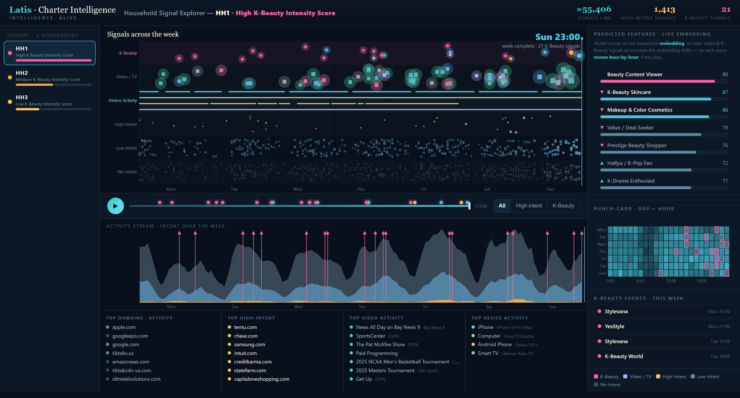
What Latis Sees: K-Beauty relevance, context & intent in motion
↗ ENLARGE
The true Latis asset is the view of the whole journey, not just a single K-Beauty moment
HOUSEHOLD HH1: ONE WEEK
Activity across video, web, and device
Features derived from embedding constantly change with new signal
One week of open-web + open-TV signal, hour by hour, high-intent K-beauty real TV viewing, and predictive K-beauty intelligence.
Top video, device, and web activity during the week
55,000+
signals observed
every web, video & device event
21
K-Beauty signals
the needle Latis isolates
1,400+
signals classified high-intent*
commerce, finance, travel, retail
* High intent signals are signals that provide evidence of a household’s specific interest, intent, and behaviors. Approximately 6% of all web activity is currently classified as high intent

Slide 33
* High intent signals are signals that provide evidence of a household’s specific interest, intent, and behaviors. Approximately 6% of all web activity is currently classified as high intent

Slide 34
How Latis transforms raw network signal into actionable intelligence
INGEST
ENHANCE
ENCODE
CONVERT
ACTIVATE
Raw Signal Data
Content Intelligence
Behavioral Representation
Intelligence Features
Intelligence Activation
Raw data ingested from web, video, device, and demographics into Latis
Raw web data is enhanced with content and metadata to provide context and intent
Behavioral signal is resolved to a single household identity and encoded into continuously updated embeddings
Embeddings converted into actionable features to power activation and insights
Latis embeddings and features activated to support commercial use cases
HH Identity (HHID, demographics)
Domain & App Activity
Device & Tech Signals
Video & Content
Domain Content Capture
Panel Intelligence
Semantic Analysis
Theme Extraction
Household Embeddings
Identity Tier, Intent Tier
Continuous Refresh
Propensity Scores
Affinity & Preference
Intent Signals
Cohorts & Clusters
Event & Transition
Engagement Indicators
Model Training
Data Collaboration
Agentic Workflow Enhancement
Consumer Insights
Audience-based Media Activation
Patent Pending
LATIS END-TO-END INTELLIGENCE WORKFLOW

Slide 35
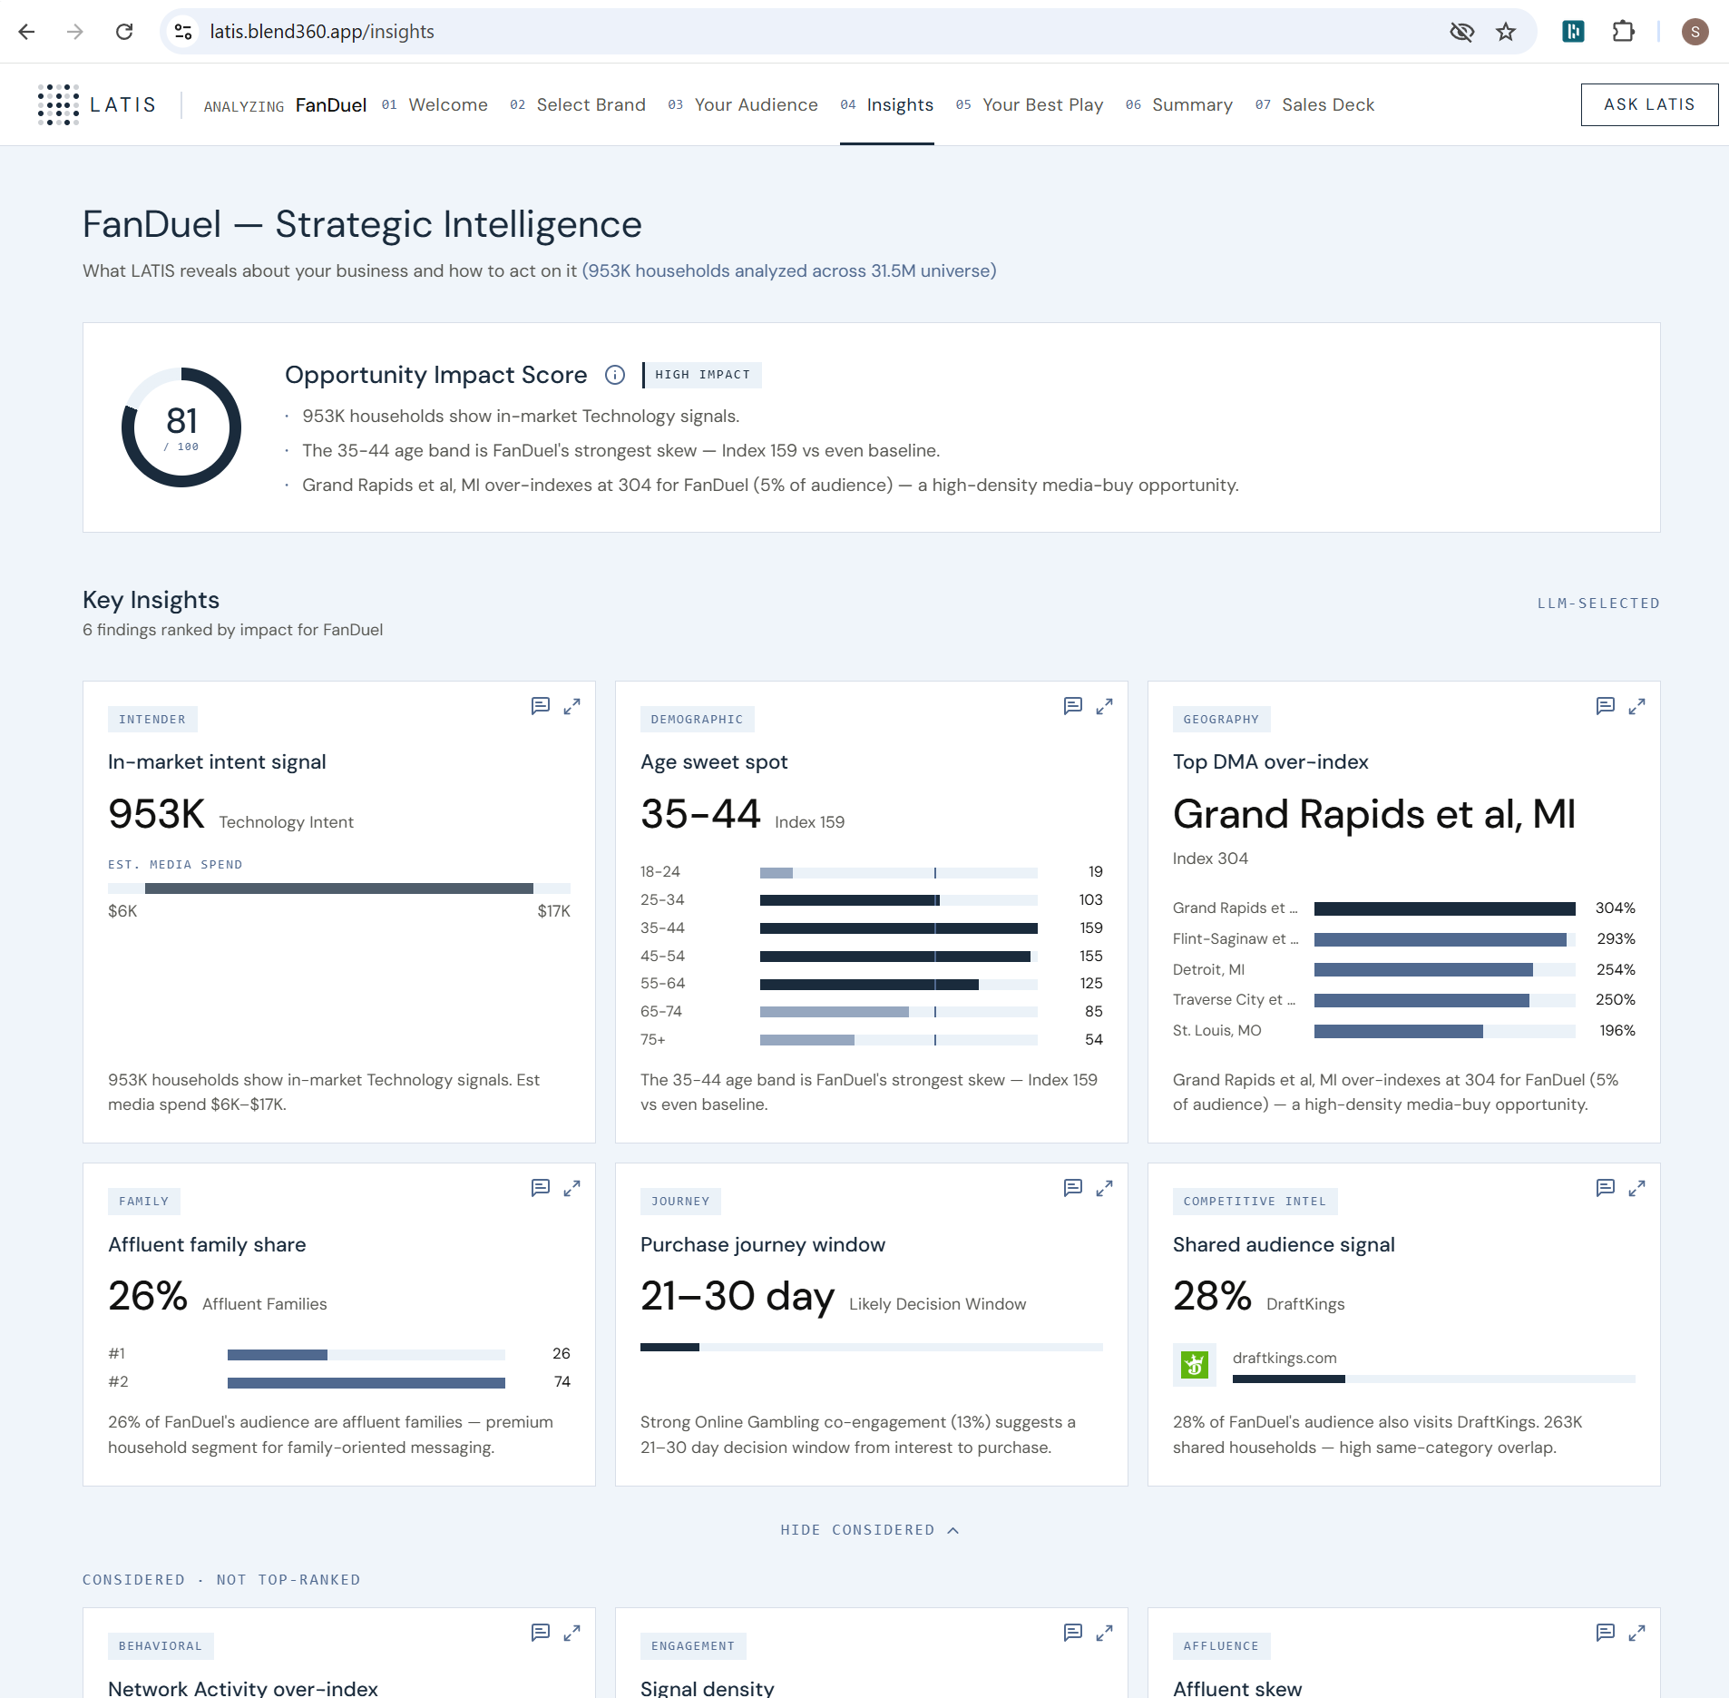
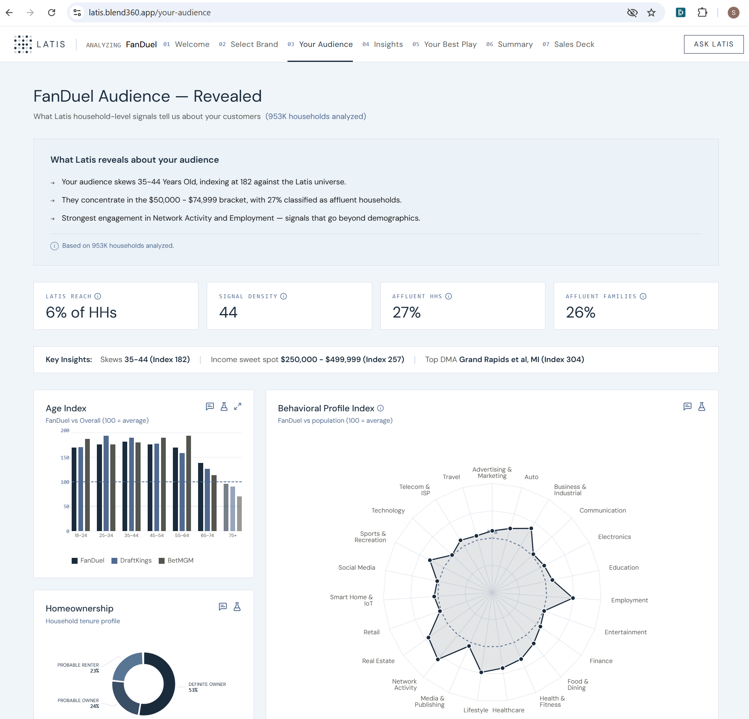
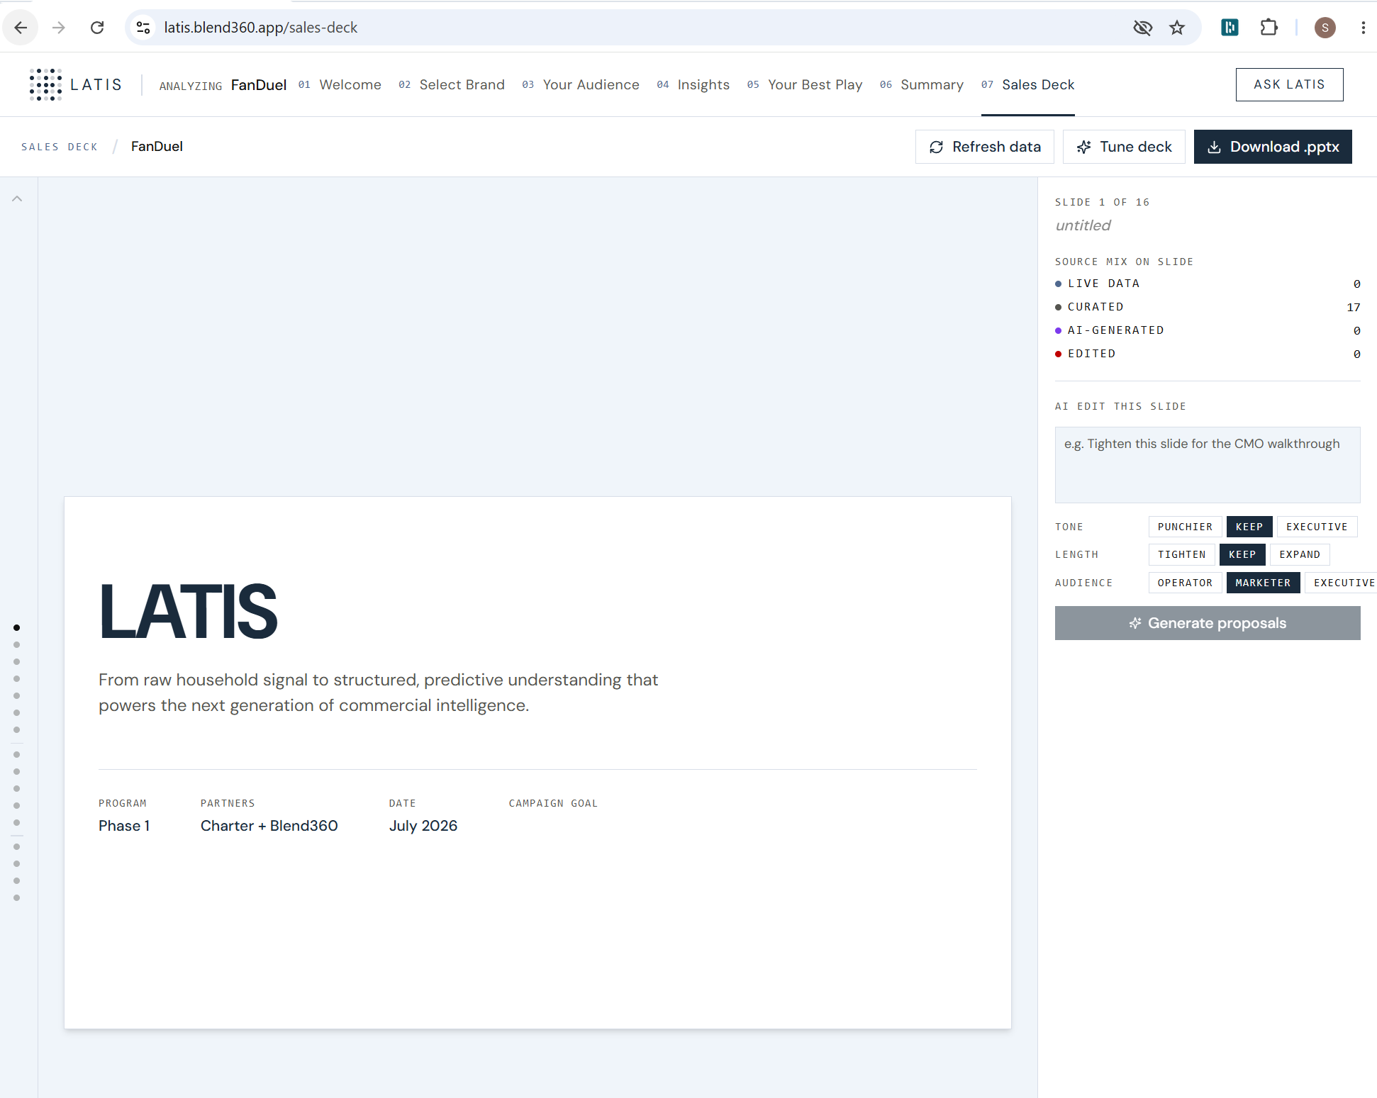
Latis Insight Studio
The first interface into the Latis platform — a live audience-intelligence app and deck generator that turns Charter household behavioral signal into a seller-ready pitch for any prospect brand, in minutes.
HOW IT WORKS
1
Name a prospect brand
the seller types any company; AI resolves it to its domain
2
Analyze live against ~30M households
audience, competitors, demographics & behavior — on the spot
3
Explore the story
9 guided screens + “Ask Latis” natural-language Q&A
4
Generate & export
an ~18-slide, source-tagged Client Brief → one-click PowerPoint
WHAT MAKES IT DIFFERENT
Live, not canned
Provenance built in
The platform’s front door
analyzes any brand against real household data in the meeting — not a pre-built report
every slide tagged Live / Curated / AI-Generated / Edited; tune tone, length & audience
beta of the client-facing Latis Intelligence Portal + API — Phase 1B, Oct–Nov

Slide 36
Why this is hard
Embeddings with no ground truth
Industrial scale
Two-tier household embeddings (stable long-term + adaptive short-term, L2-normalized concat) on an open-source model (BGE-M3) or managed service like Titan/Arctic models. No labels to fit against — validation is outcome anchoring, eval cohorts, and case-control studies.
312B events tracked weekly today — a path to 6T at enhanced signal levels. Embeddings and intelligence features re-computed and re-published daily for ~30M households.
Privacy as a design constraint
Content intelligence
Privacy preserving design. Aggregation floors, PCA compression of embeddings, privacy-reviewed model inputs. Changing approach requires re-running privacy attack suite.
A domain name is a coarse signal. We crawl site content and leverage opt-in clickstream tracking panel to classify into intent vectors to enrich every web domain visit

Slide 37
Why this matters
This hasn't been done.
FIRST
No ISP has turned national-scale network telemetry into an embedding-native intelligence platform. There is no reference implementation — we are building it.
The bet is big.
$781M
Charter's base case is $781M of new revenue in 3 years. Beta clients (FanDuel, Hims & Hers) are at final-proposal stage; Amazon and Walmart partner tracks are live.
The map gets bigger.
SCALE
Federation conversations with Comcast could extend the footprint toward national scale — and the pattern (telemetry → embeddings → clean-room intelligence) generalizes to any data-rich industry.
The unlock is the pairing: DS makes the intelligence real · AI Engineering makes it usable — neither half ships this alone.

Slide 38
Ask Us Anything

Slide 39
Questions/Comments We Received from the Team
  What is the difference between DS and AI Eng, and have we published the differences?
    Data Scientists focus primarily on ML modeling (classification, regression), exploratory analysis, optimization, and forecasting.
    AI Engineers are required to have a strong software engineering foundation and primarily focus on building solutions that leverage pre-built models (LLMs), often using an agentic pattern.
    They often work together in projects for our clients in multiple industries.
Notes:
J

Slide 40
Data Science, AI Engineering & Insights
We are using this as a recruiting reference: keywords by discipline. These are also the primary skills we used to map people to functions
Team | Brief Description | Techniques (what they do) | Technologies (what they use)
Data Science | Builds predictive machine learning models and runs investigative analysis to drive a specific business action (e.g., who to target, what to forecast, where to intervene). | Classification, regression, feature engineering, hypothesis testing, statistical modeling, recommendation engine, forecasting, optimization, experimentation, A/B testing, causal inference | Python, XGBoost, CatBoost, LightGBM, scikit-learn, Jupyter, Snowflake, SQL
AI Engineering | Builds and productionizes GenAI and agentic solutions — systems that reason, generate, retrieve information, orchestrate workflows, and take actions through tools and APIs. | Software engineering, prompt engineering, context engineering, harness engineering, fine-tuning, agentic workflow design, retrieval-augmented generation, multi-agent orchestration, synthetic data/persona generation | LLMs (GPT, Claude, etc.) and multi models, LangChain/LangGraph, vector databases, RAG frameworks, Python, harnesses + skills + tools, evaluation and observability frameworks
Insights | Transforms data into strategic business impact by building enterprise dashboards, advanced analytics solutions, and self-service reporting platforms. | Dashboarding, data visualization, reporting, KPI tracking, self-service analytics, metrics design, ELT design, (some) LLM-powered insight generation | Tableau, Power BI, DAX, SQL, Snowflake, Python, AIrflow
A note on shared skills: DS, AI Eng, and Insights candidates increasingly show light data engineering, CI/CD, and DevOps experience. This is a positive signal, not a red flag — don't let it discount a candidate. Just confirm the core techniques/technologies above are present.
Note: definitions are directional, not exhaustive — use judgment for candidates spanning multiple areas.

